Slide 1
Demand Analysis and Forecasting - Rothman
Can Yang, Haode Sun, Kangtong Guo, Xinyu Jia, Xujia Zhang

Slide 2
Demand Analysis and Forecasting-Rossmann
1
2
Background
Data Description
3
4
Approach and Methods
Data Analysis
5
6
Forecast Analysis
Future Work
&Limitation

Slide 3
Background
Opportunity
Leverage customer and store data to support decision making
Discuss how to better improve business performance
Rossmann
Common Types of Forecasting
Rossmann is the first German brand to introduce discount health and beauty retail concept to the nation
Rossmann had progressed rapidly and became the market leader in northern Germany with 100 stores.
Qualitative techniques: used in new technology areas
Time series analysis: suitable for predict with clear and stable trends.
Causal models: with historical data and sufficient analysis

Slide 4
Approach and Methods
Data Description
Data Wrangling
Data Analysis
Prophet
Linear Regression
Forecast Model
Feature Engineering
Decision Tree Regressor
Gradient Boosting Regressor
Random Forest Regressor

Slide 5
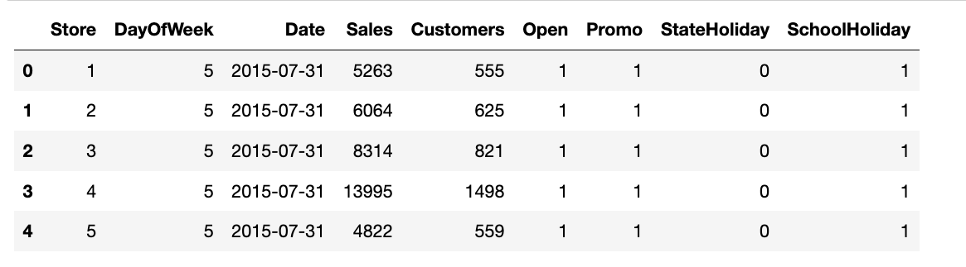
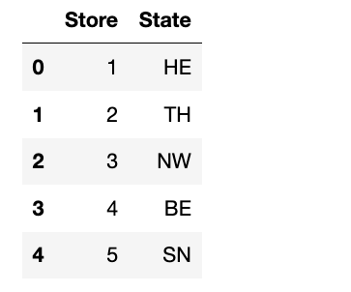
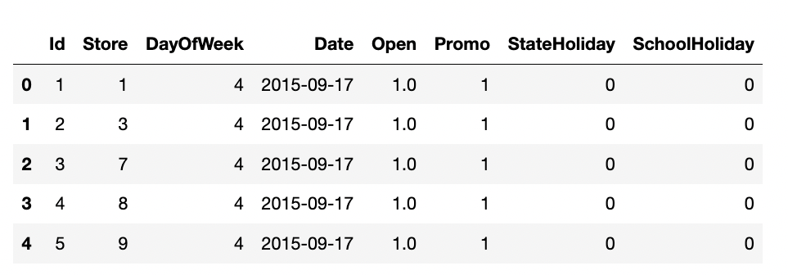
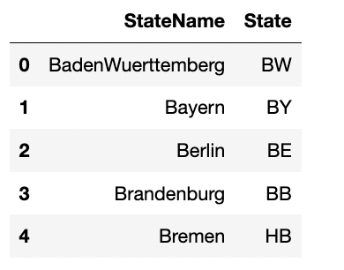
Description of Data
state_names
store_states
Train
Test
Store
Train
Store_states
Figure 1
Figure 3
Test
Store_names
Figure 2
Figure 4

Slide 6
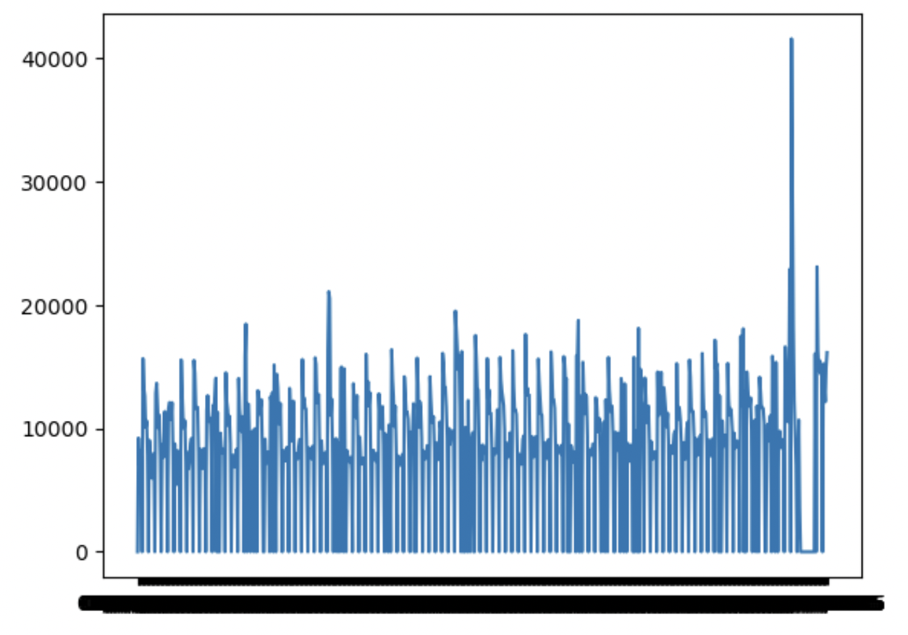
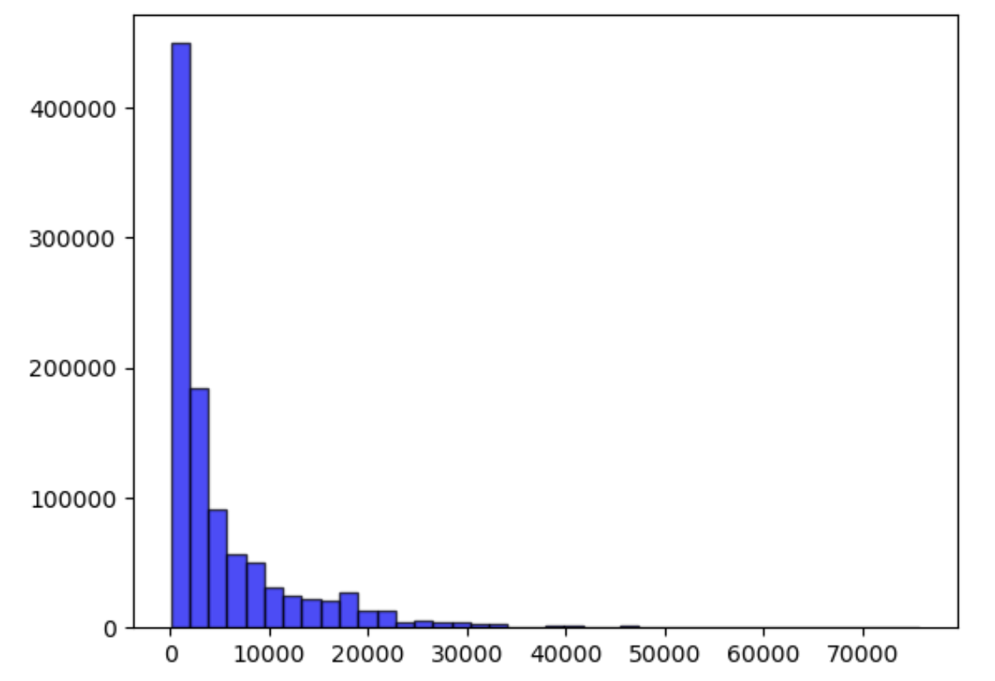
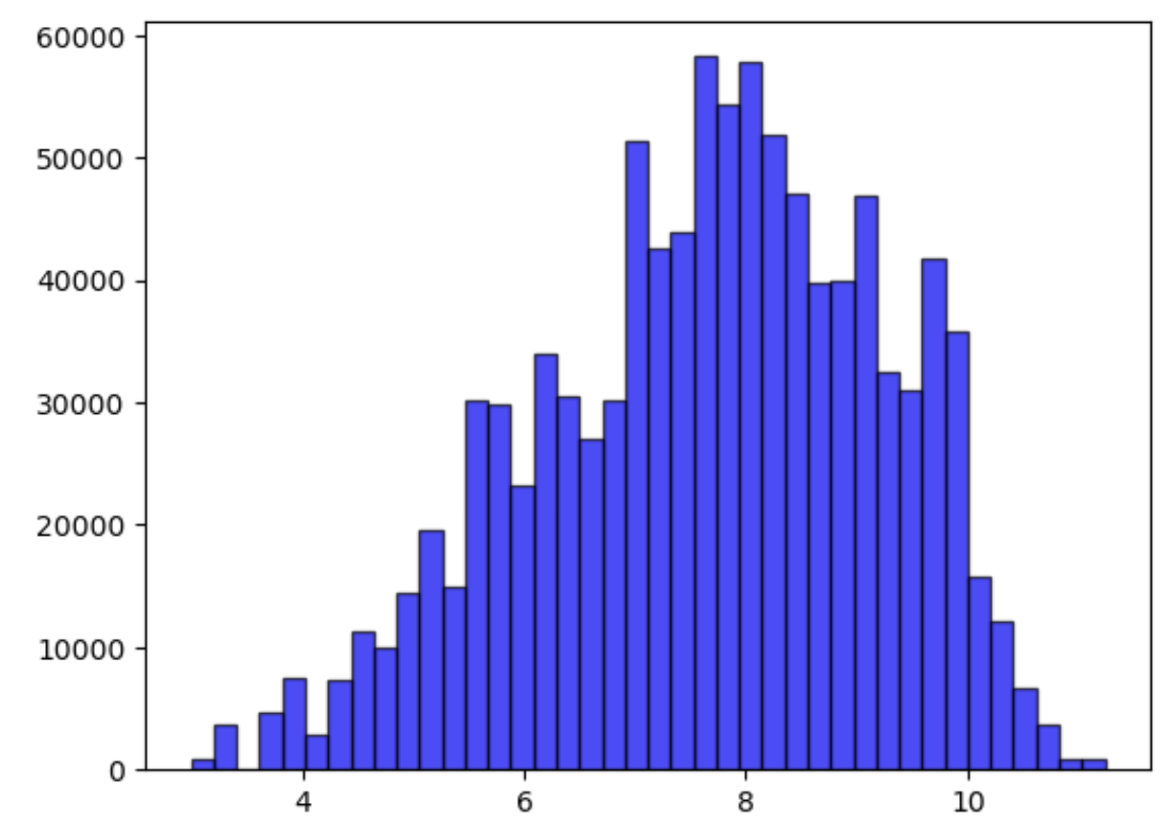
Data Analysis-data processing
1.Find and remove outliers
2.Fill in missing values and do logarithmic changes
after transformation
Figure 6
Figure 5
3.Delete last month two columns
4.Add variable Promo2SinceWeeks
5.Delete Promo2SinceWeek' ,'Promo2SinceYear
6.Discard samples with stores closed and zero turnover
Figure 7

Slide 7
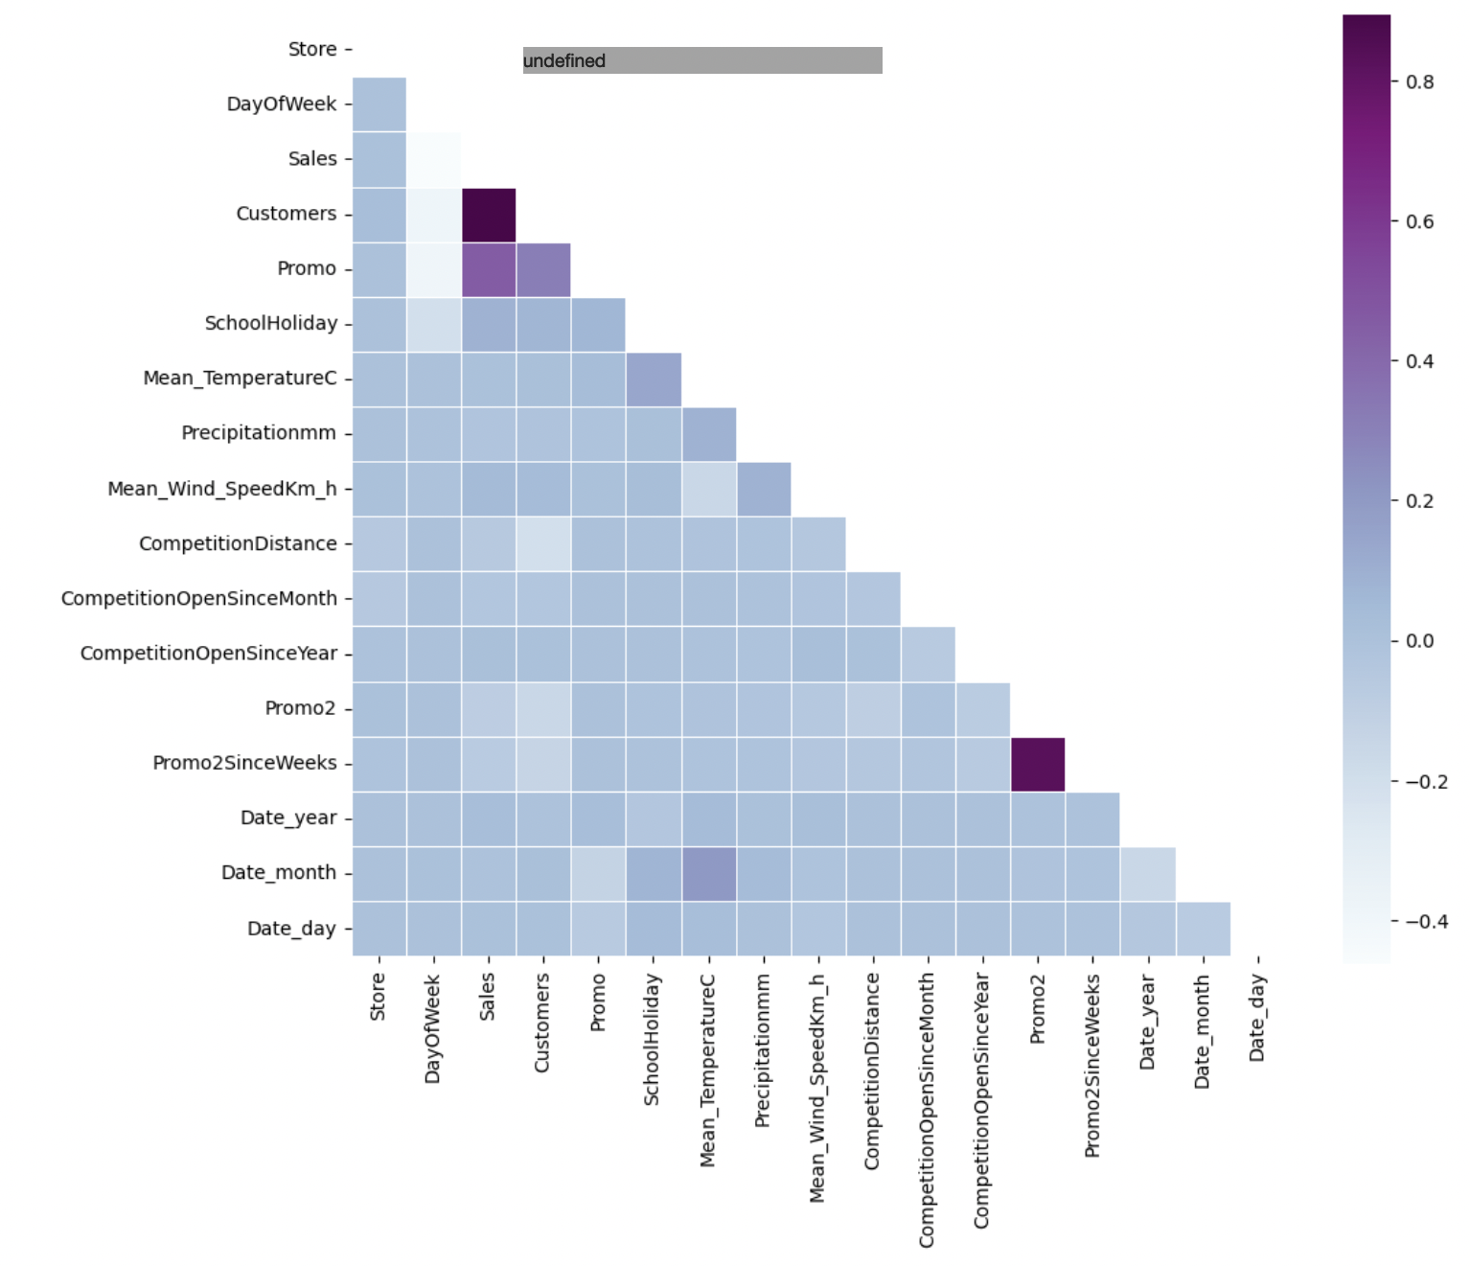
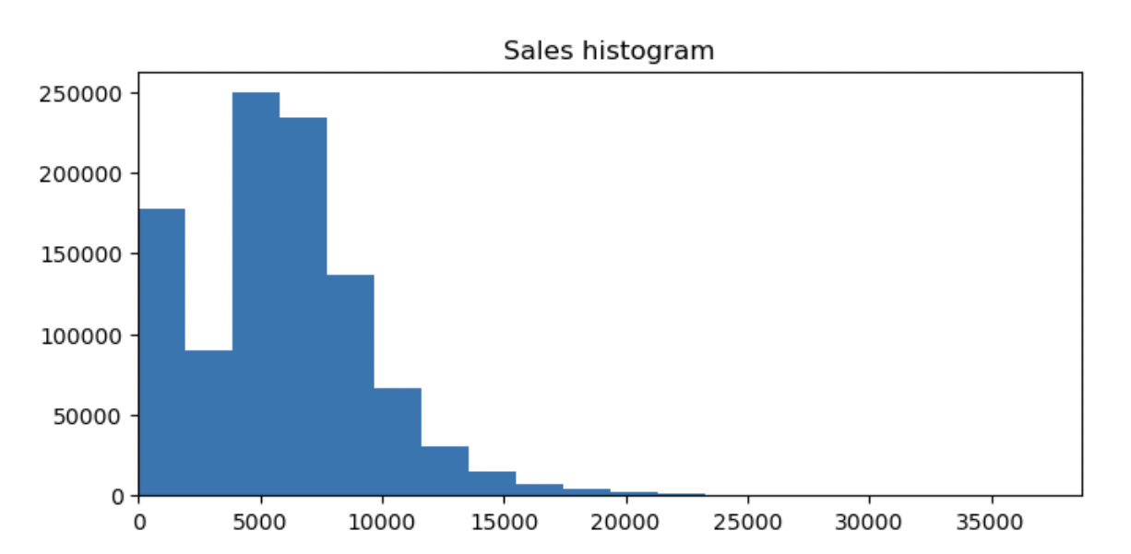
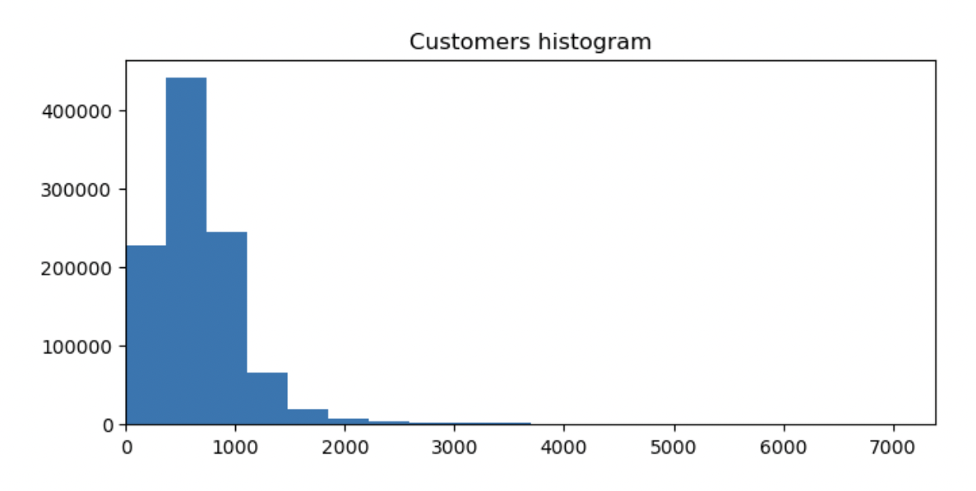
Data Analysis-Data Overview
Element heatmap
Changes in sales and number of customers per year
Sales
Figure 9
Customers
Figure 8
Figure 10

Slide 8
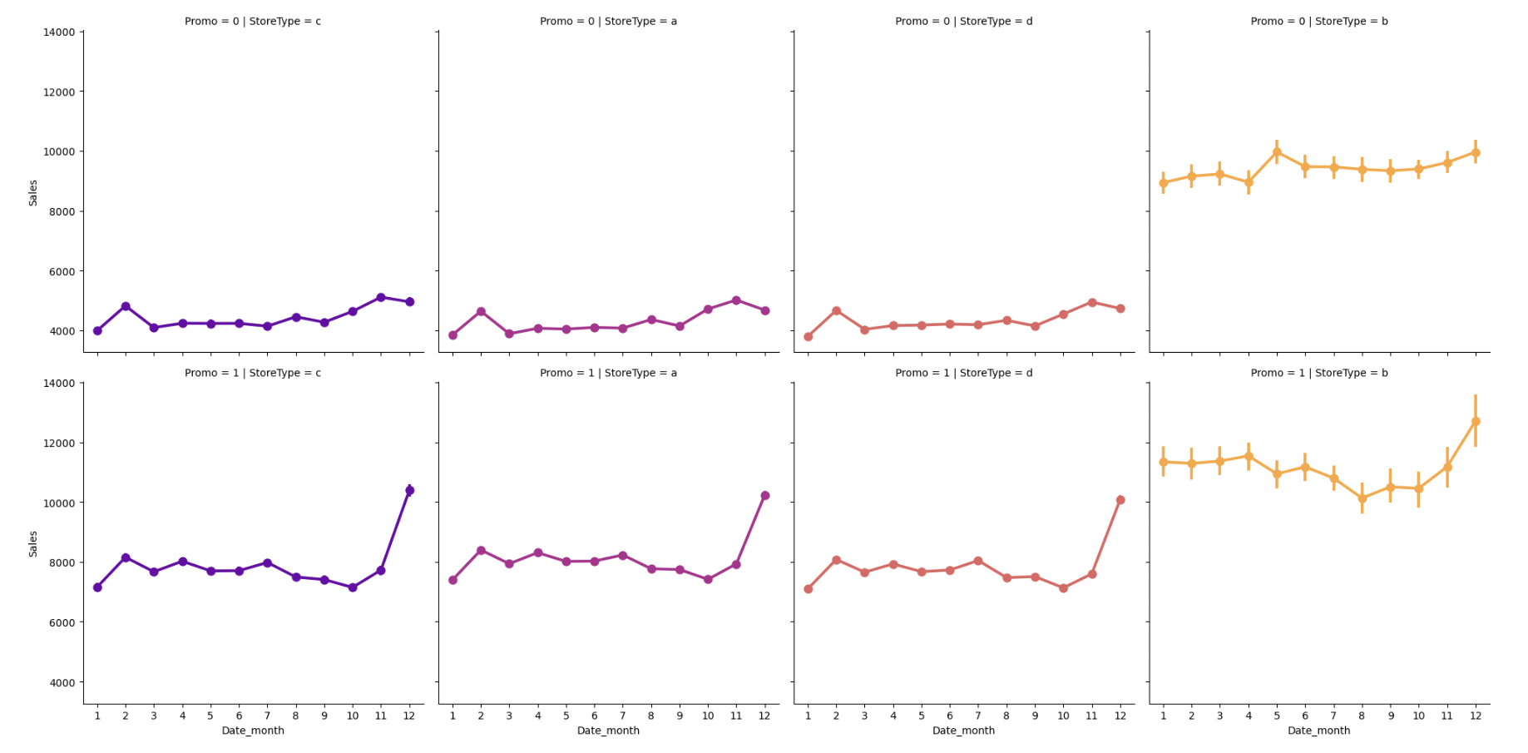
Data Analysis - Data Visualization
Effects of Promotions on Different Types of Stores
Figure 11

Slide 9
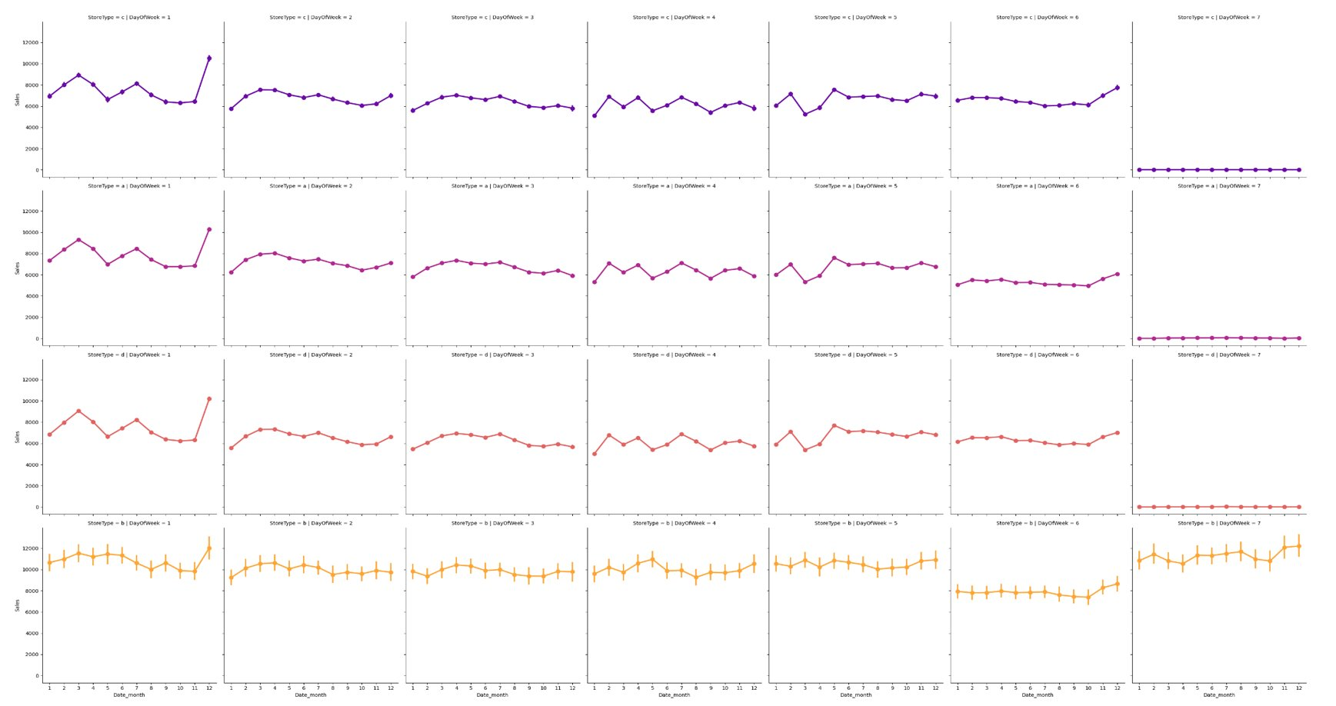
Data Analysis - Data Visualization
Sales volume of different types of stores on working days and non-working days​
Figure 12

Slide 10
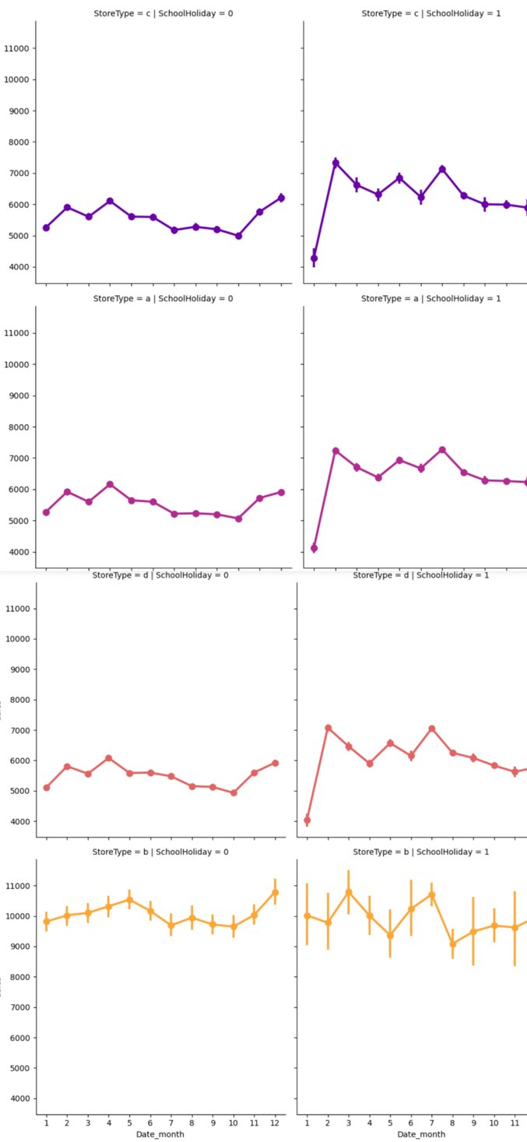
Data Analysis - Data Visualization
Impact of school holidays on sales of different types of stores
Figure 13

Slide 11
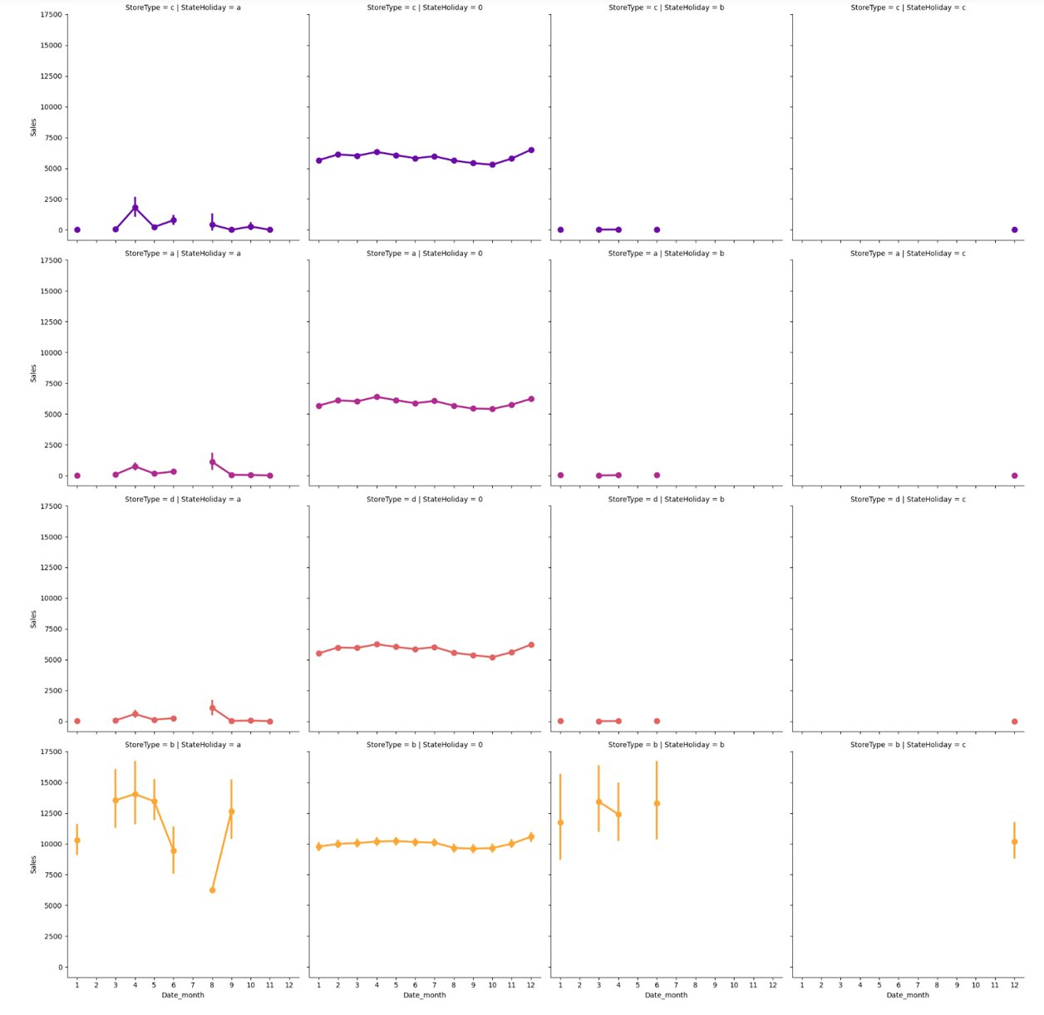
Data Analysis - Data Visualization
Impact of stateholidays on sales of different types of stores
Figure 14

Slide 12
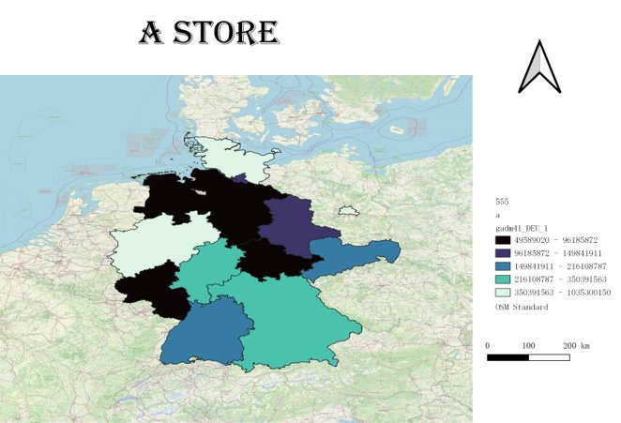
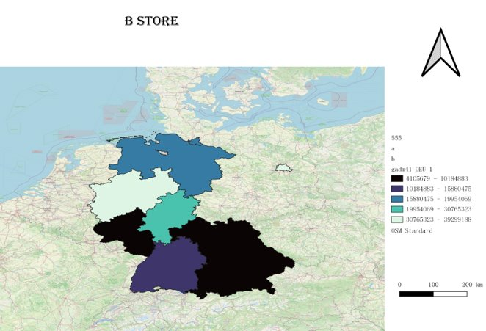
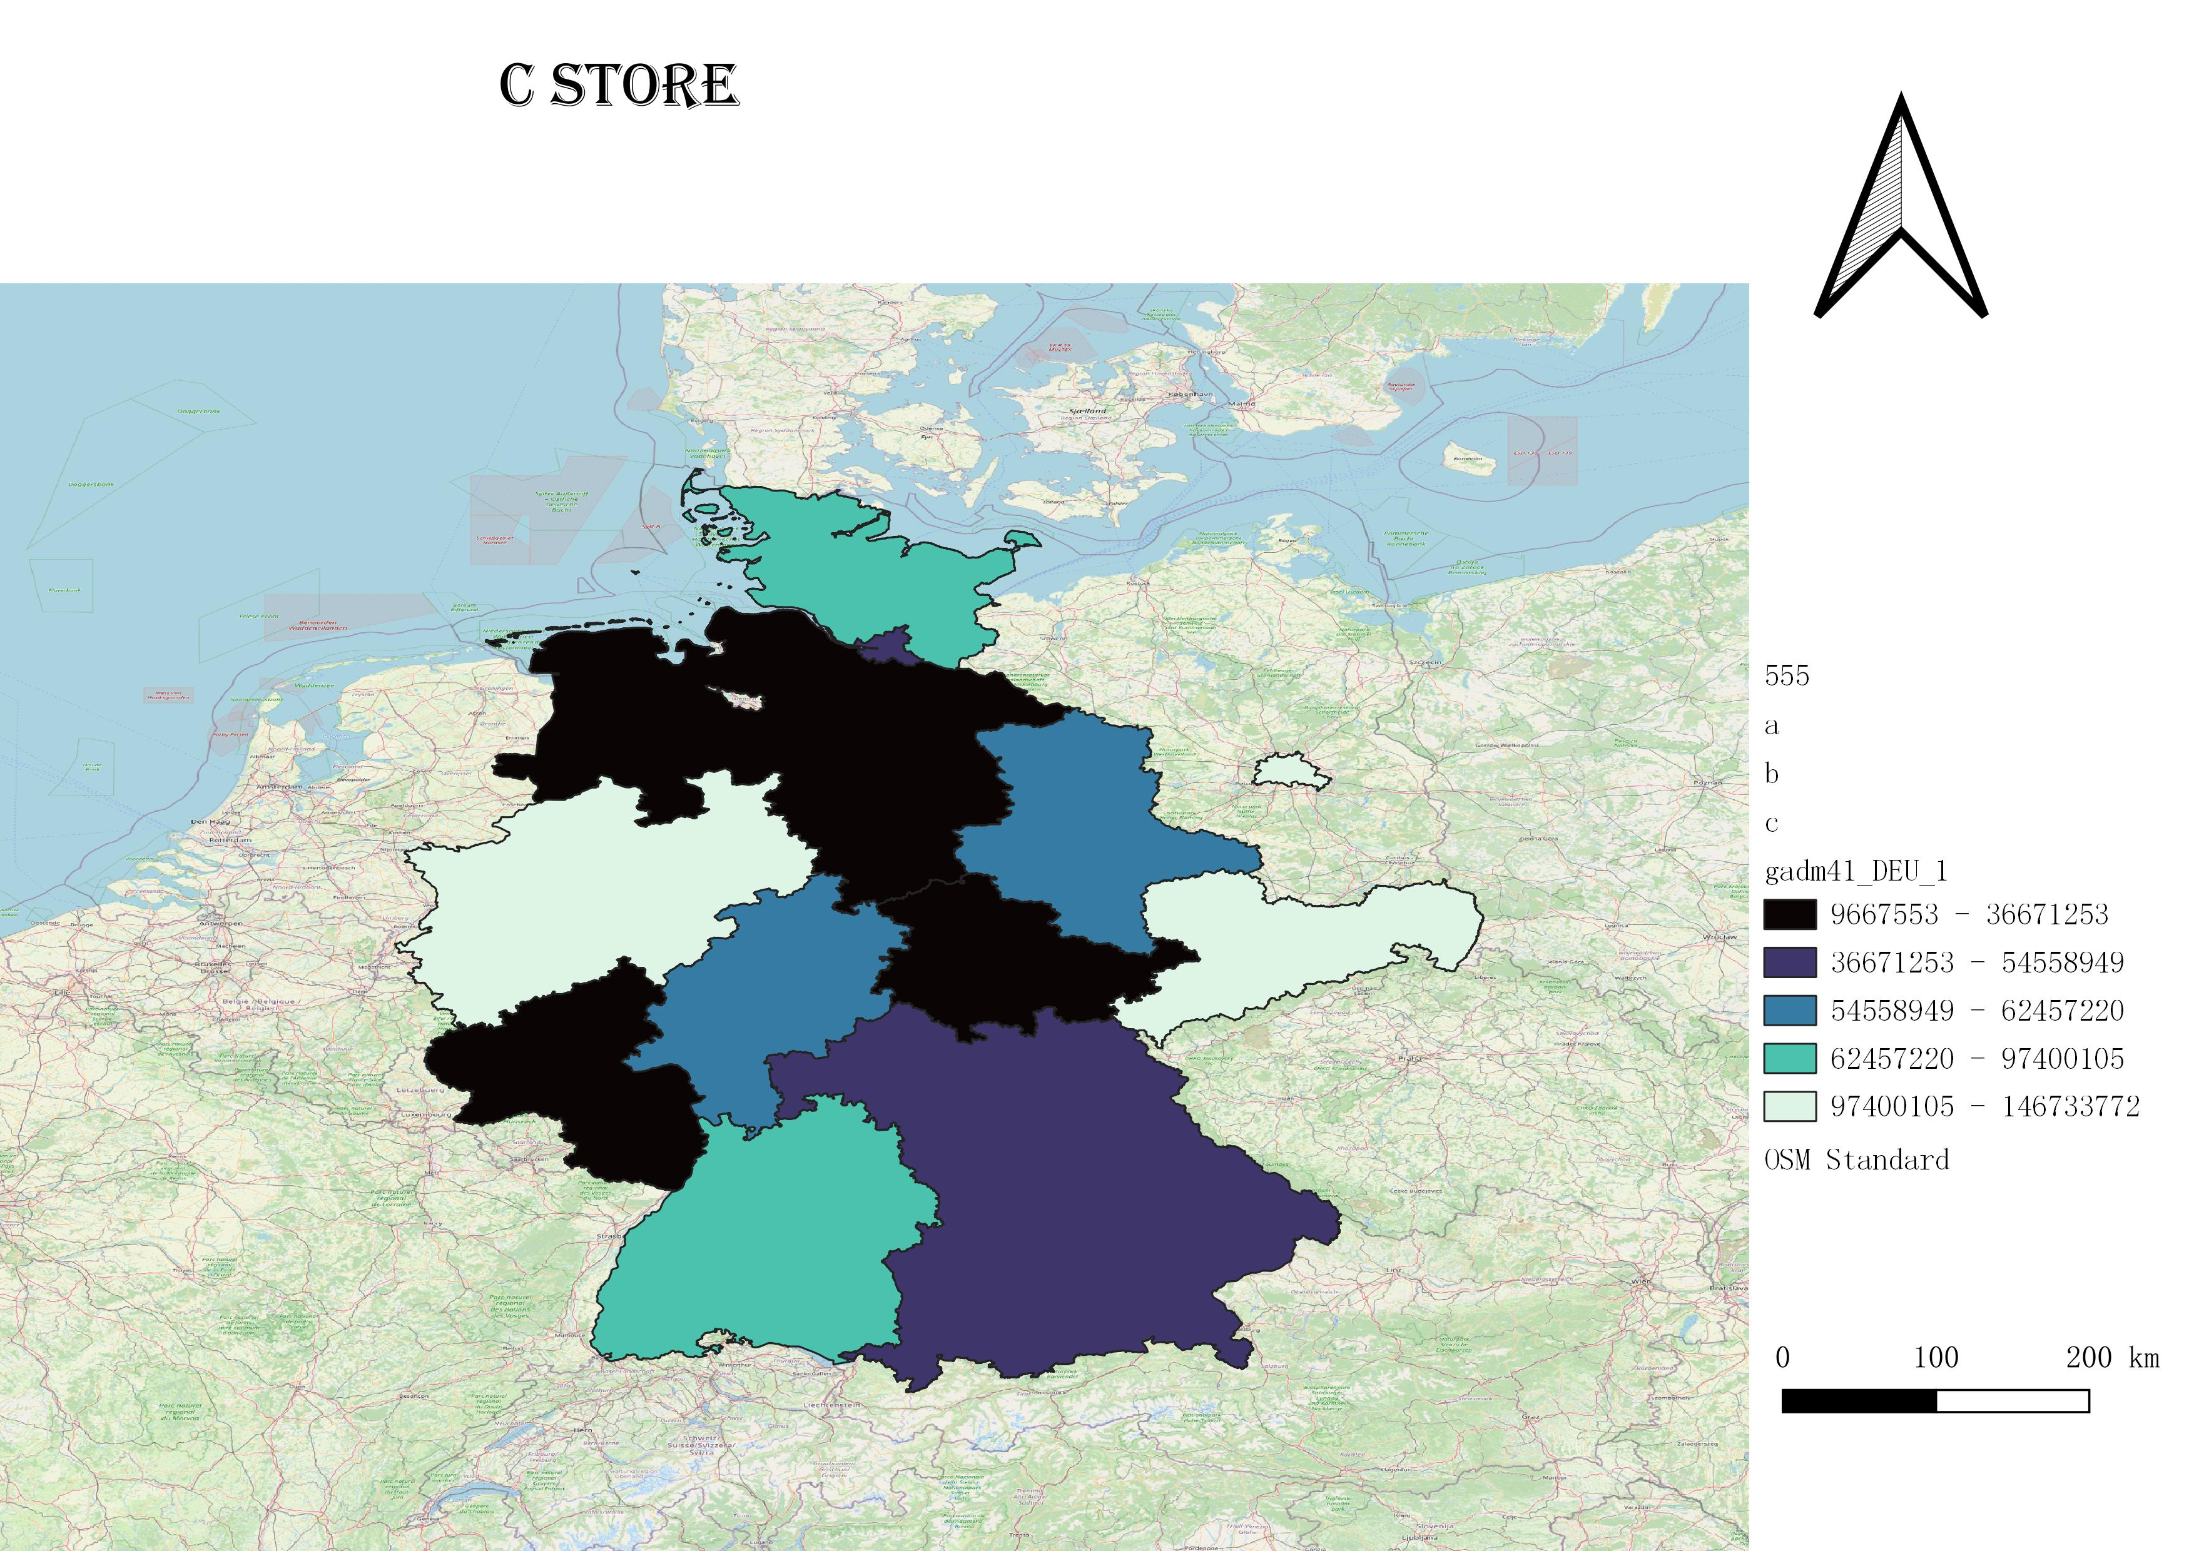
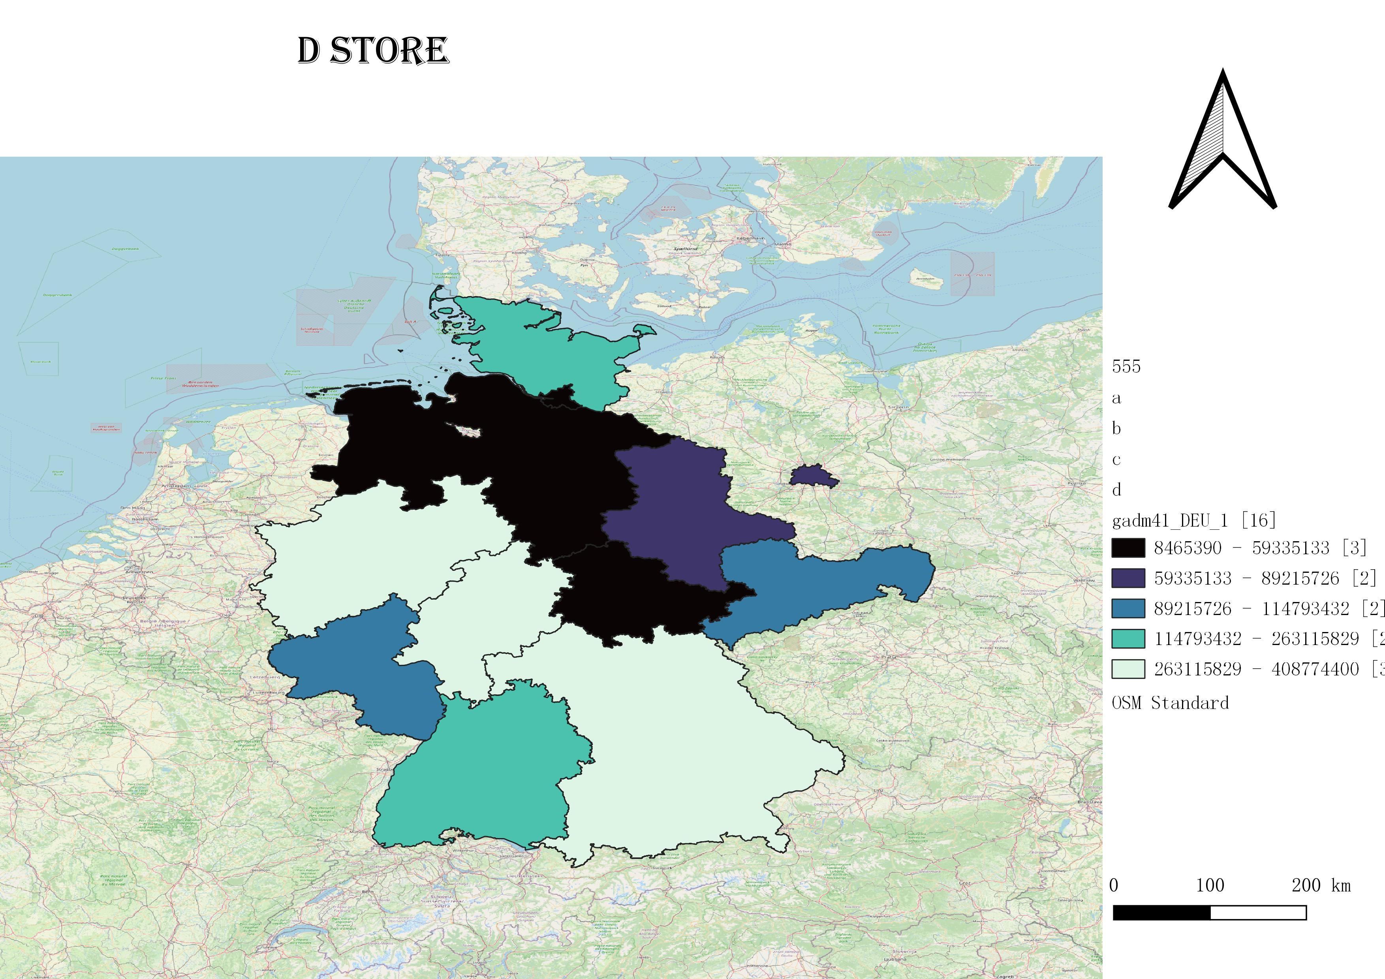
Data Analysis-spatial analysis of sales volume
Spatial Distribution of Sales in Different Types of Stores
Uneven distribution
Stores a, c, and d are not distributed in 4 districts, and store b is not distributed in 8 districts
sales rankings
Different types of stores have different sales rankings in different regions
Figure 15

Slide 13
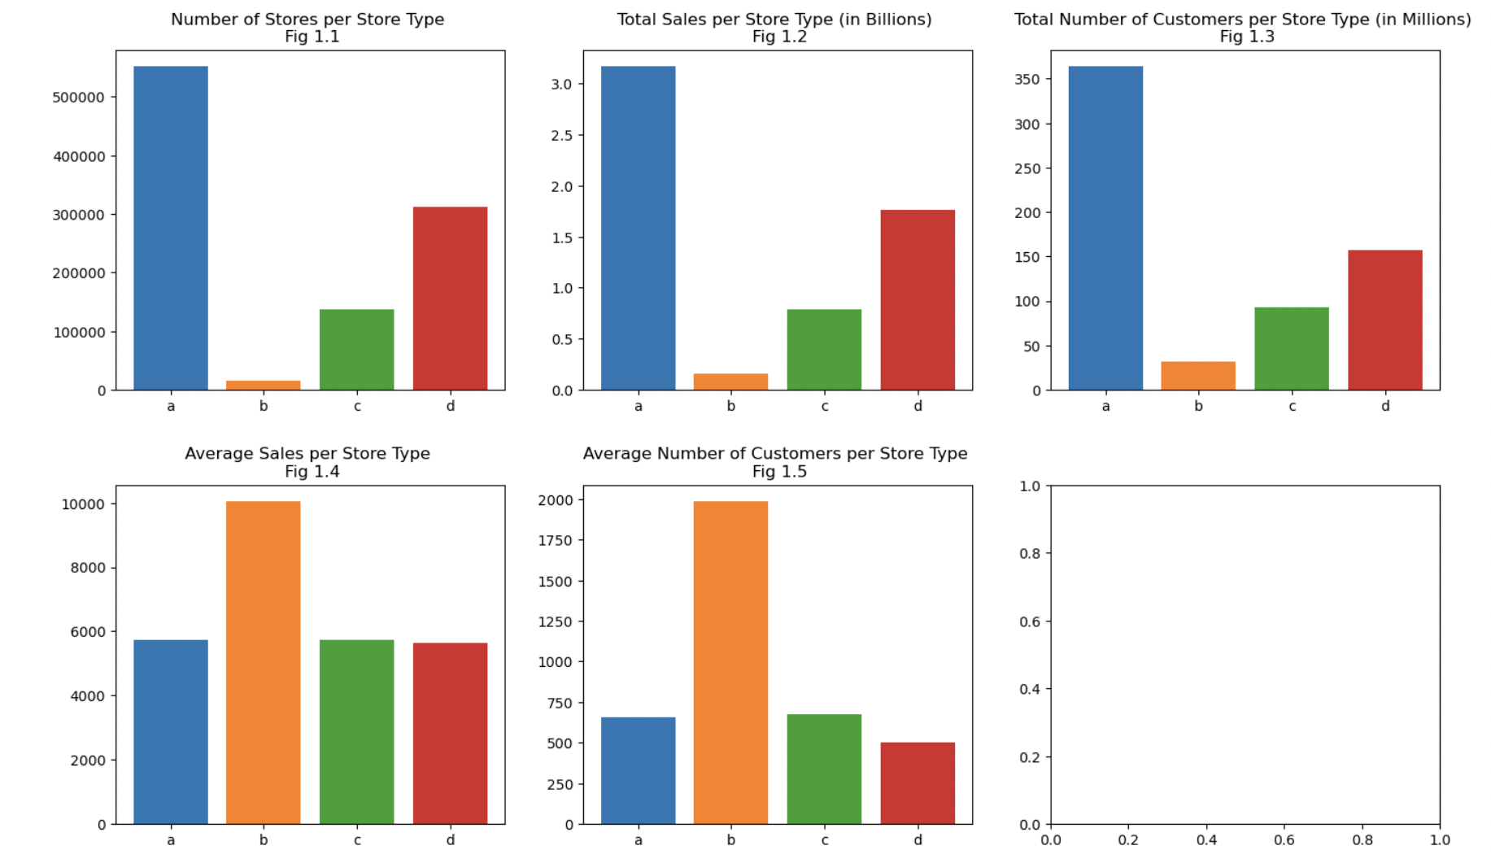
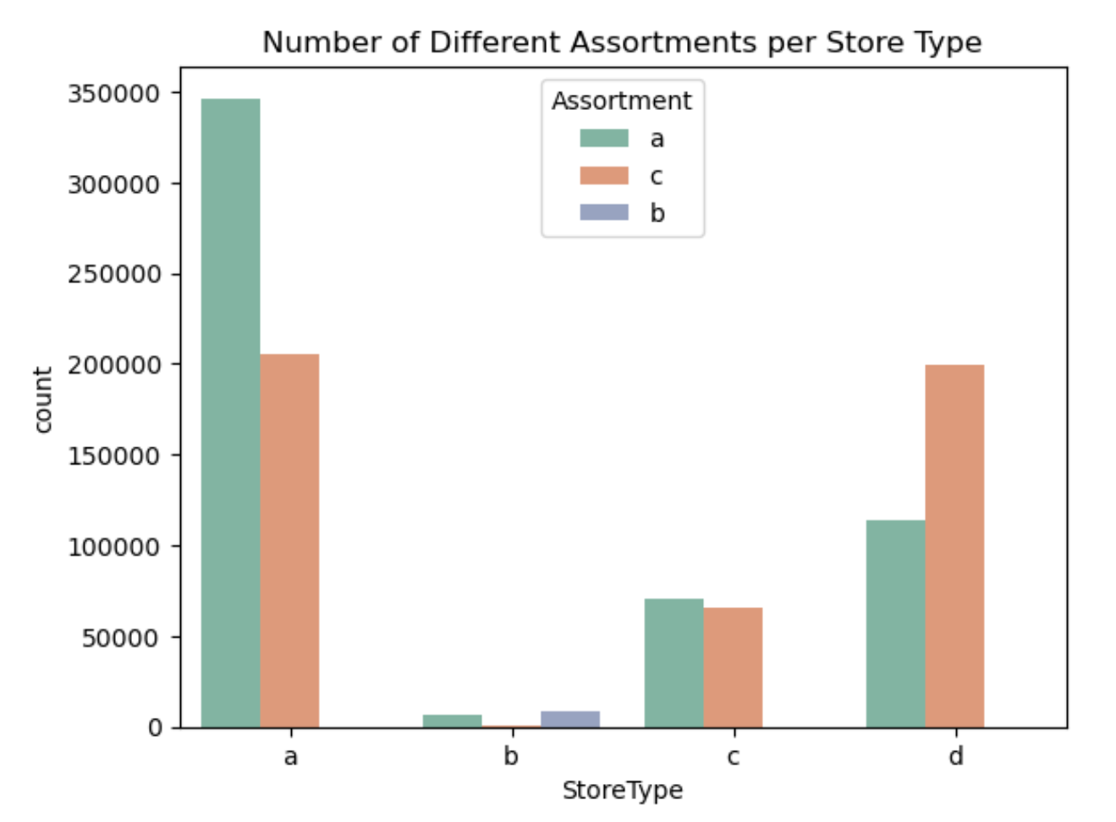
Data Analysis- why we choose store ‘a'？
Assortment: a = basic, b = extra, c = extended
Figure 16
Figure 17
The total number of stores, total sales and customers in store a are far higher than those in other stores
The average sales and average number of customers of store a are similar to those of other stores
The number of stores a is the largest, and the basic type stores are far more than other stores

Slide 14
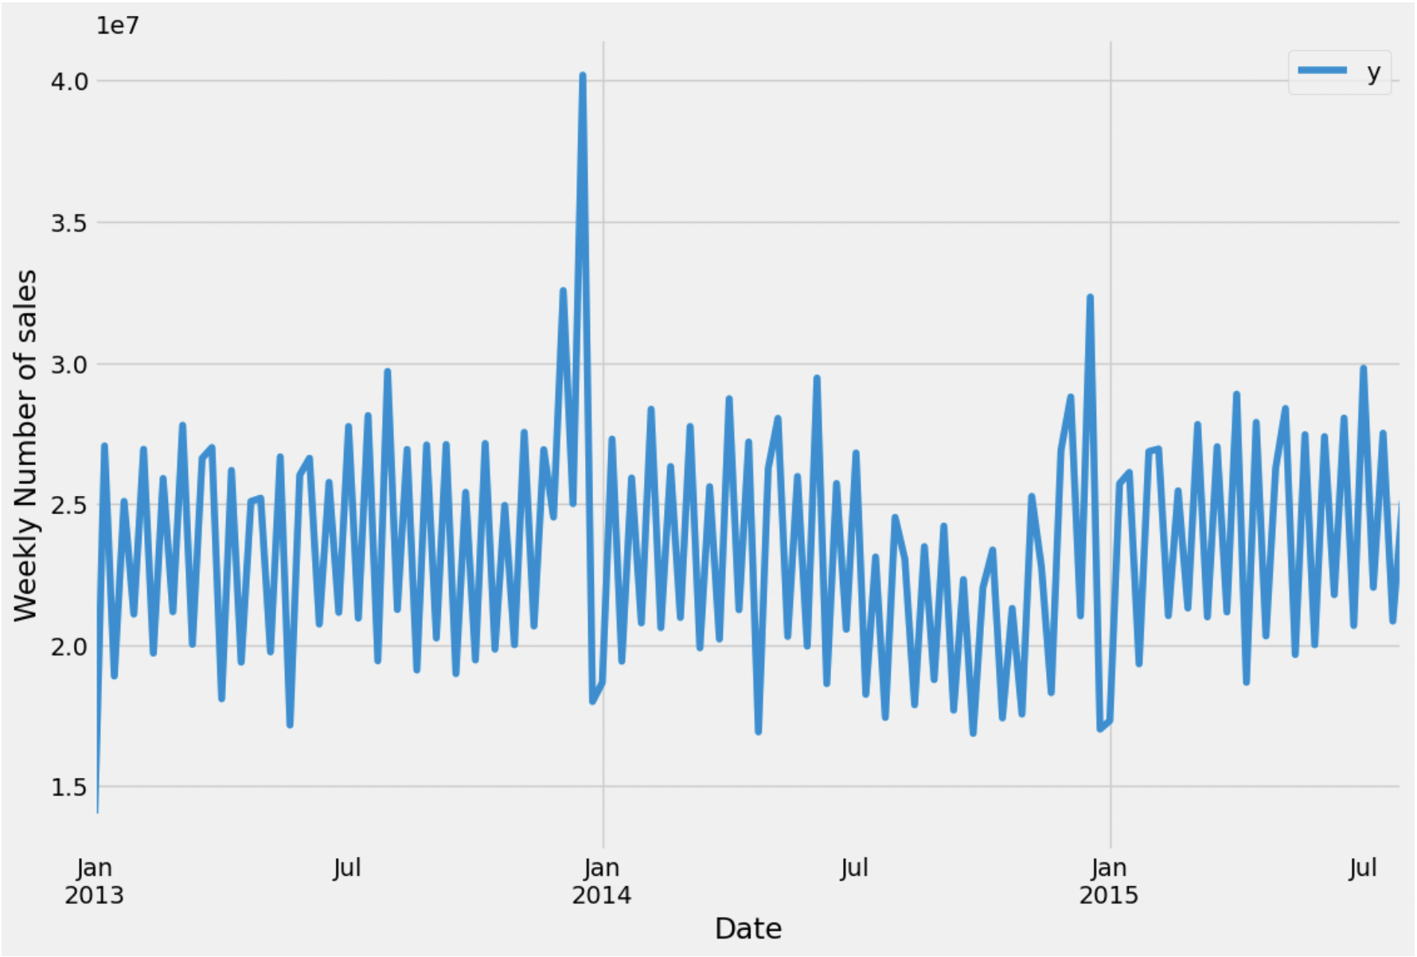
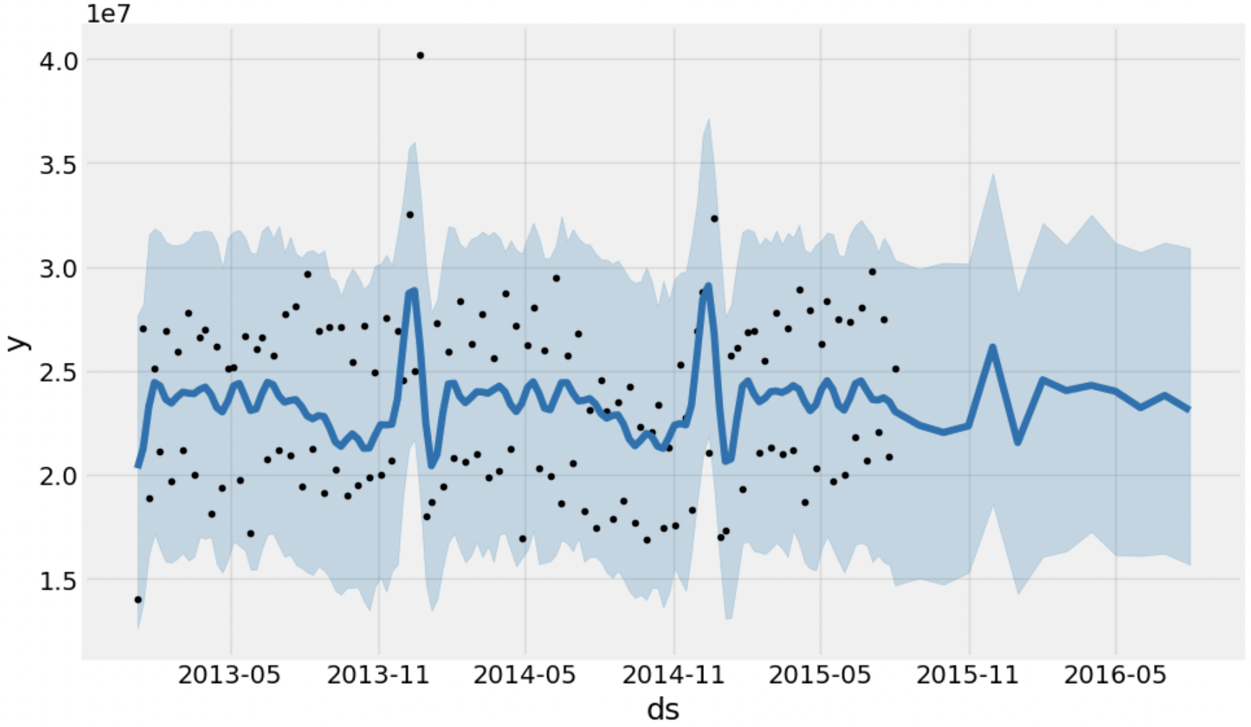
Forecast Analysis—Prophet
The plot above represents the visualization data of store A's weekly sales from January 2013 to July 2015.
Almost every year around December sales reach a peak.
The plot below represents the prediction of sales with the prophet model.
A slow downward trend from August 2015 - November 2015, followed by a rise, peaking around December, before falling again and eventually levelling off.
Figure 18
Figure 19
Notes:
We are looking to predict future values of our time series one year into the future.
Prophet plots the observed values of our time series (the black dots), the forecasted values (blue line) and the uncertainty intervals of our forecasts (the blue shaded regions).

Slide 15
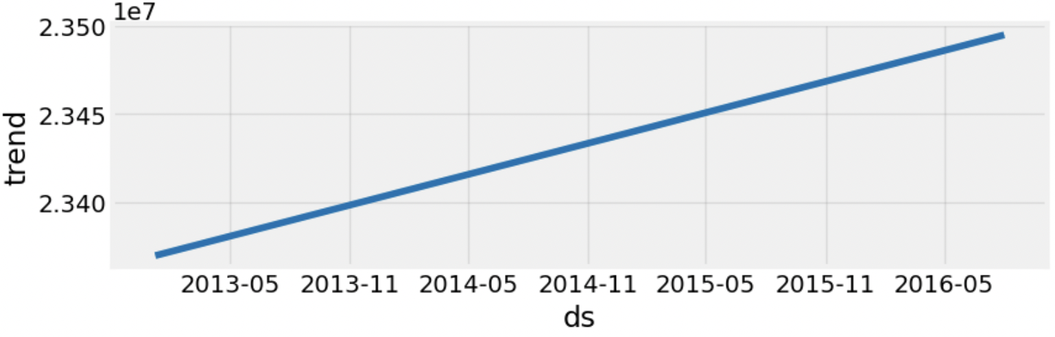
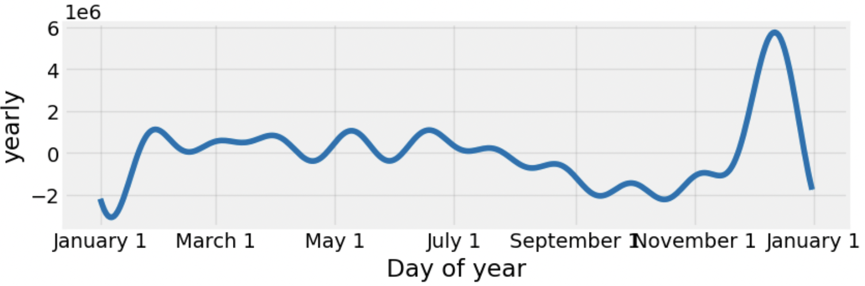
Forecast Analysis—Plotting the forecasted components
The first plot shows that the weekly volume of sales has been linearly increasing over time.
The second plot shows that the largest sales occurs during the months of February and December.
Figure 20
Figure 21
Notes:
Another particularly strong feature of Prophet is its ability to return the components of our forecasts.
This can help reveal how daily, weekly and yearly patterns of the time series contribute to the overall forecasted values.

Slide 16
Forecast Modeling—Machine Learning Method (cross_val_score)
model | 0 | 1 | 2 | 3 | 4 | mean | std
Lr_model | 0.569101 | 0.569961 | 0.570956 | 0.568883 | 0.569902 | 0.569760 | 0.000734
Tree_model | 0.611801 | 0.608037 | 0.615249 | 0.610808 | 0.609766 | 0.611132 | 0.002406
Rfr_model | 0.689484 | 0.687019 | 0.692625 | 0.687995 | 0.687995 | 0.688970 | 0.001996
Gbdt_model | 0.646806 | 0.649195 | 0.646593 | 0.647646 | 0.647646 | 0.647739 | 0.000982
Sheet 1

Slide 17
Forecast Analysis-Conclusion
 | MSE | R²
Lr_model | 6.727429e+06 | 0.570969
Tree_model | 5.998547e+06 | 0.617453
Rfr_model | 4.869550e+06 | 0.689452
Gbdt_model | 5.499765e+06 | 0.649262
Sheet 2

Slide 18
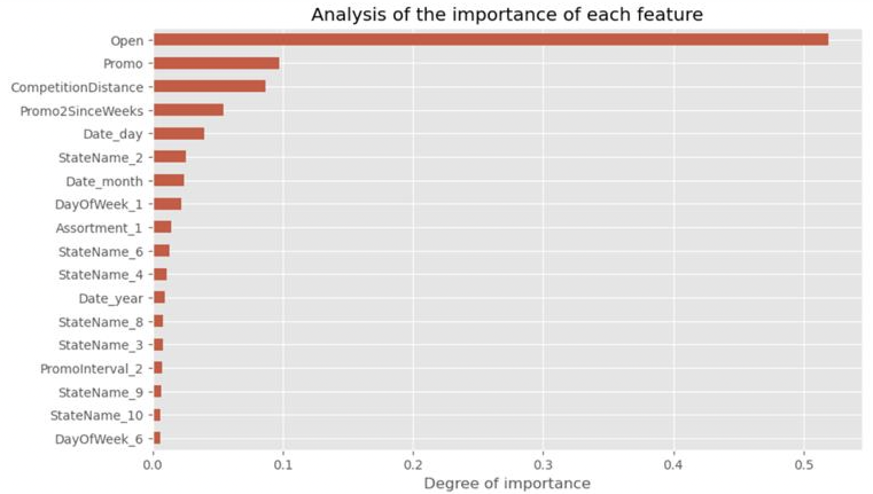
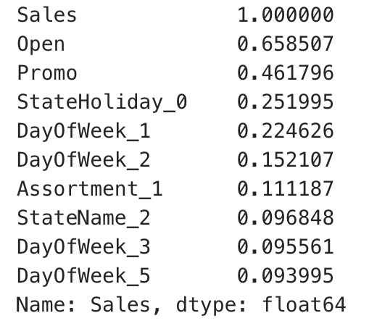
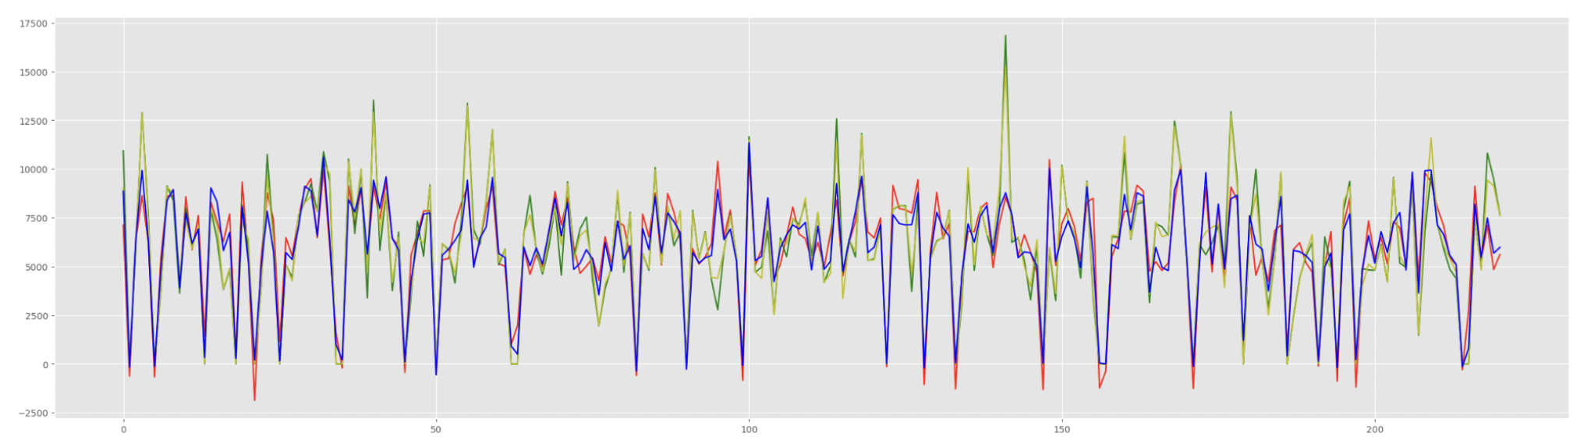
Forecast Modeling
The top ten columns with positive correlations
after prediction
lr_model
tree_model
rfr_model
gbdt_model
Figure 22

Slide 19
Future work Limitation
Does not take into account the characteristics of consumers in different regions and cannot make targeted recommendations
Select more predictive models to test in order to get the optimal model.
Optimising the model by adjusting the parameters
There is no universality in analysing just one typr shop and making predictions.

Slide 20
References
A.S. Watson Group - World’s largest international health & beauty retailer, leader in O+O retail. (2015). Rossmann. [online] Available at: https://www.aswatson.com/our-brands/health-beauty/rossmann/.
Brownlee, J. (2017). Introduction to time series forecasting with python: how to prepare data and develop models to predict the future. Machine Learning Mastery.
Catal, C. , Ece, K. , Arslan, B. & Akbulut, A. (2019). Benchmarking of Regression Algorithms and Time Series Analysis Techniques for Sales Forecasting . Balkan Journal of Electrical and Computer Engineering , 7 (1) , 20-26 . DOI: 10.17694/bajece.494920
kaggle.com. (n.d.). Tutorial: Time Series Forecasting with Prophet. [online] Available at: https://www.kaggle.com/code/prashant111/tutorial-time-series-forecasting-with-prophet.

Slide 21
Thank you!
Can Yang, Haode Sun, Kangtong Guo, Xinyu Jia, Xujia Zhang

